Slide 1
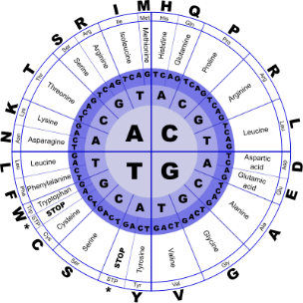
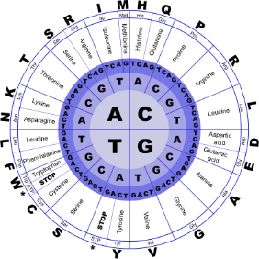


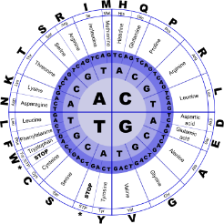
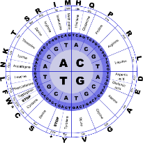
Fundamentals of Programming II
C++ - Introduction

Slide 2
Why Program?
Computer – programmable machine designed to follow instructions
Program/Software – instructions in computer memory to make it do something
Programmer – person who writes instructions (programs) to make computer perform a task
SO, without programmers, no programs; without programs, the computer cannot do anything

Slide 3
Computer & Programming
Computers can be programmed
Designed to do any job that a program tells them to
Program
Commonly referred to as Software
Programmer
Also known as software developer
Set of sequential instructions that a computer follows to perform a task
Person who can design, create, and test computer programs

Slide 4
Hardware and Software
Hardware
Computer is a system
Typical major components
Central processing unit
Main memory
Secondary storage devices
Input and output devices
Composed of several components that all work together
The physical devices that make up a computer

Slide 5
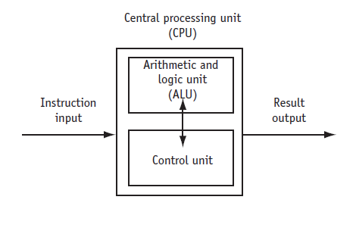
CPU
Central processing unit (CPU)
Most important component
Without it, cannot run software
Microprocessors
Part of the computer that actually runs programs
CPUs located on small chips
Control Unit
Retrieves and decodes program instructions
Coordinates computer operations
Arithmetic & Logic Unit (ALU)
Performs mathematical operations

Slide 6
Main Memory
Main memory
Random Access Memory or RAM
Volatile memory used for temporary storage while program is running
Contents are erased when computer is off
CPU is able to quickly access data in RAM
Where computer stores a program while program is running, and data used by the program

Slide 7
Secondary Storage Devices
Secondary storage
Programs normally stored here and loaded to main memory when needed
Types of secondary memory
Disk drive
Flash memory
Optical devices
Can hold data for long periods of time
magnetically encodes data onto a circular disk
portable, no physical disk
data encoded optically

Slide 8
Input Devices
Input
Input device
Examples: keyboard, mouse, scanner, camera
Disk drives can be considered input devices because they load programs into the main memory
Data the computer collects from people and other devices
Component that collects the data

Slide 9
Output Devices
Output
Can be text, image, audio, or bit stream
Output device
Examples: video display, printer
Disk drives and CD recorders can be considered output devices because data is sent to them to be saved
Data produced by the computer for other people or devices
Formats and presents output

Slide 10
Software
Software
General categories
Application software
System software
Application software
Examples: word processing, email, games, Web browsers, web services
Programs that make computer useful for every day tasks
Controls everything the computer does

Slide 11
Software (cont’d.)
System software
Operating system
Utility Program
Software development tools
Programs that control and manage basic operations of a computer
controls operations of hardware components
performs specific task to enhance computer operation or safeguard data
used to create, modify, and test software programs

Slide 12
How Computers Store Data
Data
Byte
Divided into eight bits
Bit
The on/off pattern of bits in a byte represents data stored in the byte
Just enough memory to store letter or small number
Electrical component that can hold positive or negative charge, like on/off switch
Raw Facts
Computer stores them in sequences of 0’s and 1’s

Slide 13
Storing Numbers
Bit
Computers use binary numbering system
Position of digit j is assigned the value 2^{j-1}
To determine value of binary number sum position values of the 1’s
Byte size limits are 0 and 255
0 = all bits off; 255 = all bits on
To store larger number, use several bytes
Smallest piece of memory
Stands for binary digit
Has values 0 (off) or 1 (on)
Is 8 consecutive bits
Has an address
Word
Usually 4 consecutive bytes
8 bits
0 1 1 0 0 1 1 1
1 byte

Slide 14




Storing Numbers
Binary Number | 1 | 0 | 0 | 1 | 1 | 1 | 0 | 1
 | ON | OFF | OFF | ON | ON | ON | OFF | ON
Power of 2 | 2⁷ | 2⁶ | 2⁵ | 2⁴ | 2³ | 2² | 2¹ | 2⁰
 | 128 | 64 | 32 | 16 | 8 | 4 | 2 | 1
 | multiply
 | 128 | 0 | 0 | 16 | 8 | 4 | 0 | 1
Decimal Representation of Binary | 157

Slide 15
Storing Numbers
Binary Number | 0 | 1 | 0 | 0 | 0 | 0 | 0 | 1
 | OFF | ON | OFF | OFF | OFF | OFF | OFF | ON
Power of 2 | 2⁷ | 2⁶ | 2⁵ | 2⁴ | 2³ | 2² | 2¹ | 2⁰
 | 128 | 64 | 32 | 16 | 8 | 4 | 2 | 1
 | multiply
 | 0 | 64 | 0 | 0 | 0 | 0 | 0 | 1
Decimal Representation of Binary | 65
ASCII Table | A

Slide 16
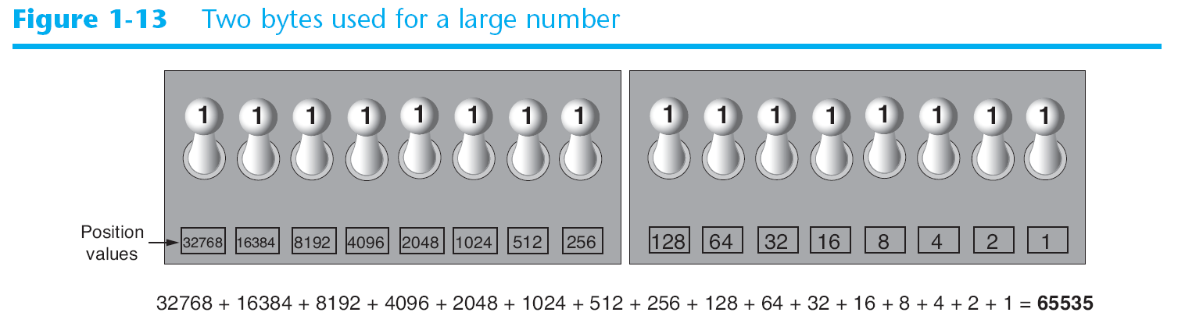
Other Types of Data

Slide 17
Storing Characters
Data stored in computer must be stored as binary number
Characters are converted to numeric code, numeric code stored in memory
Most important coding scheme is ASCII
ASCII is limited
Unicode coding scheme becoming standard
Compatible with ASCII
Can represent characters for other languages
defines codes for only 128 characters

Slide 18
Storing Characters
Data stored in computer must be stored as binary number
Characters are converted to numeric code, numeric code stored in memory
Most important coding scheme is ASCII
ASCII is limited
Unicode coding scheme becoming standard
Compatible with ASCII
Can represent characters for other languages
defines codes for only 128 characters

Slide 19
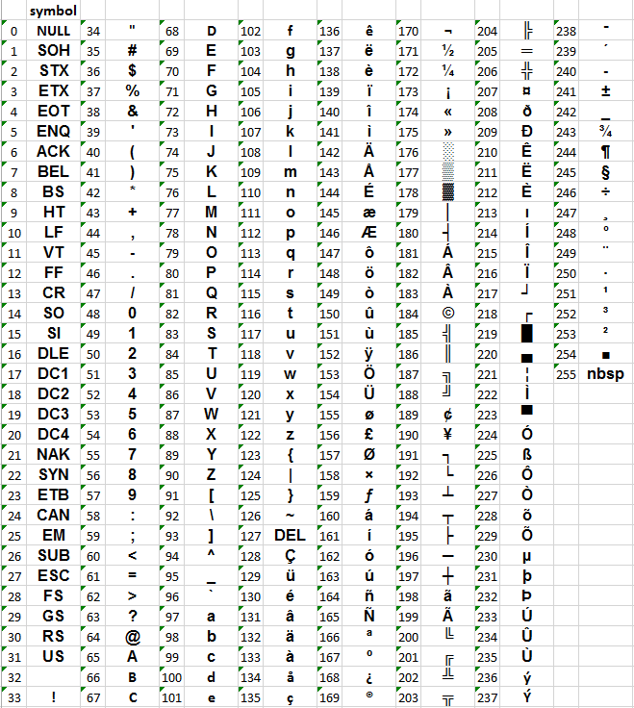
The ASCII Character Set

Slide 20
Advanced Number Storage
To store negative numbers and real numbers
Negative numbers encoded using two’s complement
Real numbers encoded using floating-point notation
Computers use binary numbering and encoding schemes

Slide 21
Other Types of Data
Digital
Pixels
To store images, each pixel is converted to a binary number representing the pixel’s color
Samples
To store music, each sample is converted to a binary number
Describes any device that stores data as binary numbers
Digital images are composed of pixels
Digital music is composed of sections called samples

Slide 22

Binary Number Conversion

Slide 23
How a Program Works
CPU designed to perform simple operations on pieces of data
Examples: reading data, adding, subtracting, multiplying, and dividing numbers
Understands instructions written in machine language and included in its instruction set
Each brand of CPU has its own instruction set
To carry out meaningful calculation, CPU must perform many operations

Slide 24
How a Program Works
Program must be copied from secondary memory to RAM each time CPU executes it
CPU executes program in cycle
Fetch
Decode
Execute
read the next instruction from memory into CPU
CPU decodes fetched instruction to determine which operation to perform
perform the operation

Slide 25
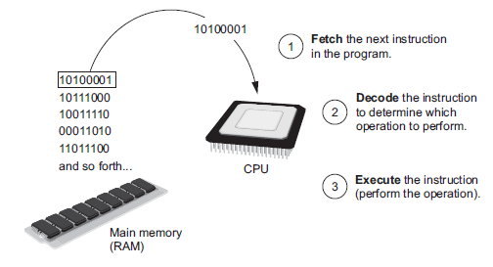
How a Program Works

Slide 26
Machine Language -Assembly Language
Impractical for people to write in machine language
Assembly language
Easier for programmers to work with
Assembler
Uses short words (mnemonics) for instructions instead of binary numbers
Translates assembly language to machine language for execution by CPU

Slide 27
High-Level Languages
Low-level language
Example: assembly language
High-Level language
No need to know how CPU works or write large number of instructions
More intuitive to understand
Close in nature to machine language
Allows simple creation of powerful and complex programs

Slide 28
High-Level Languages

Slide 29
Compilers and Interpreters
Programs written in high-level languages
Compiler
Machine language program can be executed at any time
Translates high-level language program into separate machine language program
Must be translated into machine language to be executed

Slide 30
Compilers and Interpreters
Interpreter
Used by Python language
Interprets one instruction at a time
No separate machine language program
Source code
Syntax error
Translates and executes instructions in high-level language program
Statements written by programmer
Prevents code from being translated at any time

Slide 31
Compilers and Interpreters

Slide 32
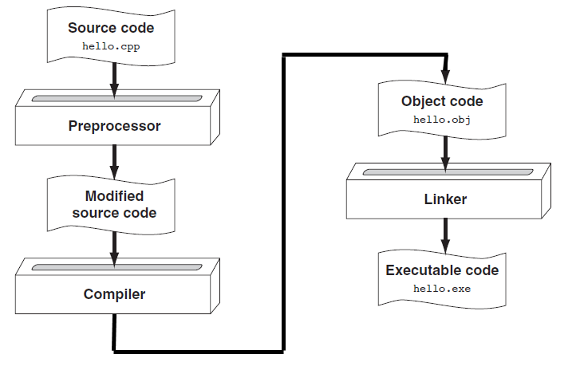
High-level Program to an Executable File

Slide 33
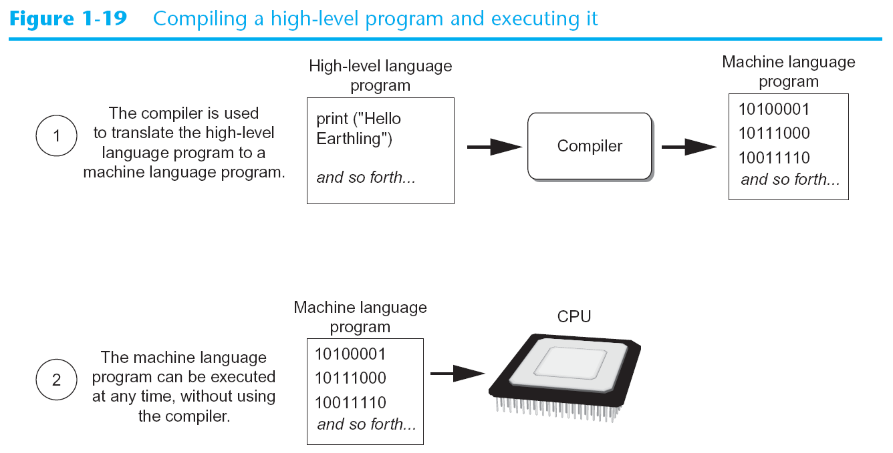
Compilers and Interpreters

Slide 34
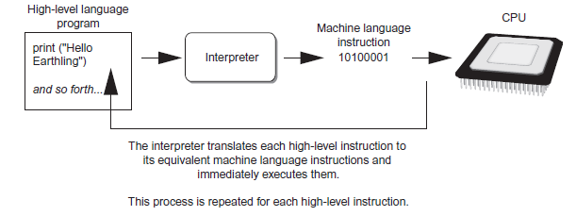
Compilers and Interpreters
Executing a high-level program with an interpreter

Slide 35
Key Words, Operators, and Syntax
Key words
Each key word has specific meaning
Operators
Example: math operators to perform arithmetic
Statement
Predefined words used to write program in high-level language
Perform operations on data
Individual instruction used in high-level language to understand

Slide 36
Programming Components
Semantics
Set of rules to be followed when writing program
Syntax
Run-Time
Error in logic or arithmetic
In error that occurs while a program is running
It is related to Semantics of the code detected in running the code

Slide 37
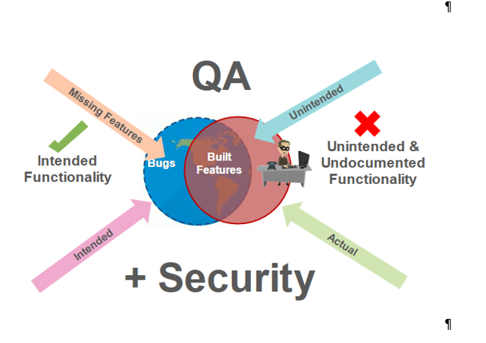
Programming Components

Slide 38
C++
is a statically typed, compiled, general-purpose, case-sensitive, free-form programming language that supports procedural, object-oriented, and generic programming.
is regarded as a middle-level language, as it comprises a combination of both high-level and low-level language features.
was developed by Bjarne Stroustrup starting in 1979 at Bell Labs in Murray Hill, New Jersey, as an enhancement to the C language and originally named C with Classes but later it was renamed C++ in 1983.
is a superset of C, and that virtually any legal C program is a legal C++ program.

Slide 39
C++
C++ fully supports object-oriented programming, including the four pillars of object-oriented development −
Encapsulation
Data hiding
Inheritance
Polymorphism

Slide 40
Use of C++
Standard C++ consists of three important parts
The core language giving all the building blocks including variables, data types and literals, etc.
The C++ Standard Library giving a rich set of functions manipulating files, strings, etc.
The Standard Template Library (STL) giving a rich set of methods manipulating data structures, etc.

